Slide 1
Intrusion Detection Via Graph Analytics
Harsh Khandelwal, Milind

Slide 2
Objective
Develop graph analytics techniques to support different types of queries needed by Intrusion Detection Systems(IDS) for APT detection.
Queries about correlated events at different points in a system/enterprise
Finding requests causing sensitive data to be accessed
Finding Taint argument propagation

Slide 3
Problem & Context
Web application easy attack targets
Proliferation in attack methods needs better techniques to understand these attacks and defend against them
Data generated by web applications is extremely large
Since APT can continue for a prolonged duration causal graphs with a very high degree are generated
Analysing them becomes a tedious task to point out how where the attack might have occurred

Slide 4
Problem & Context (cont’d)
To handle such high volumes of data Visualization of system becomes an effective tool
An efficient representation via graph DB gives efficient support to perform such analytics

Slide 5
Background & Related Work
Backtracking intrusions - King and Chen
Finding out the potential sequence of steps that led to an attack
Effectively highlight the entry point used to gain access to the system and the sequence of events from the entry point to the point at which intrusion was detected
Taint Enhanced Policy Enforcement
Taint analysis techniques that track flow of untrusted data through the application at a very fine granularity level
Limitations:
Trade-off between policy precision and the level of effort required to write those policies
The directory traversal policies tend to generate a lot of false positives as it precludes all access outside the authorized top level directories.

Slide 6
Background & Related Work (cont’d)
BEEP
Reverse engineering system binaries and providing a log analysis algorithm for constructing causal dependency graph for attack investigation
Limitations:
Vulnerable against kernel level attacks
Works with a pre-processed set of applications. Less security if a user chooses to install a new application.
Not capable of processing obfuscated binaries

Slide 7
Data Model (3 Major Components)
Subjects
active entities that execute actions
Includes process name, process id’s, thread id’s, etc.
Objects
entities that execute no actions
Include path locations and memory addresses
Events
actions performed by the subjects
Include system calls, return values, return time and call time

Slide 8
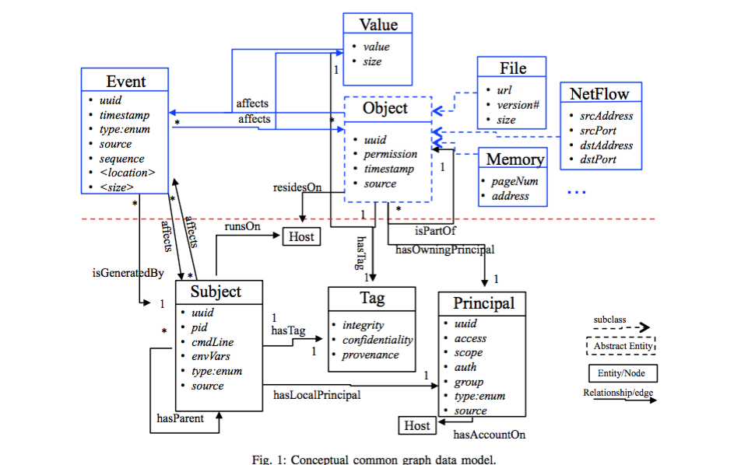

Slide 9
Graph Databases
Databases using graph structures for semantic queries (allow for analytics of associative and contextual nature)
Uses nodes, edges and properties to represent and store data
NoSQL in nature
Essentially, key-value databases with additional relationship concept added
Store data in a key-value(JSON type) store or document-oriented database(XML type)

Slide 10
Graph Databases: Advantages
Scalability
Relationships allow value in the store to be related to each other in a free form way
Traditional relational databases define relationships within the data itself
Allow complex hierarchies to be quickly traversed, addressing one of the more common performance problems found in traditional key-value stores

Slide 11
Neo4j
Most popular graph database
ACID-compliant transactional database system
Provides native graph storage and processing
Everything is stored in form of either an edge, a node or an attribute
Supports storing and fetching values from database and graph processing via a special native query language Cypher.
Relatively well documented. Hence, reason for our selection.

Slide 12
Cypher Query Language (CQL)
SQL for querying a graph
Cypher is a declarative graph query language native to neo4j
Relatively simple yet very powerful language
Allows expressive and efficient querying and updating of the graph store
Complicated queries can be easily expressed via Cypher
Supports variety of clauses like MATCH, WHERE, CREATE, DELETE
Sample Query:
MATCH (charlie :Person { name : 'Charlie Sheen' })-[:ACTED_IN]-(movie : Movie) RETURN movie

Slide 13
Approach – An Overview
Gather the system call information for the particular application (request and response objects in the case of web applications)
Store these system call information in the form of a CSV file (CSV is native to Neo4j hence makes importing data easier)
Identify node mappings and properties for the imported information based on our data model
Create a Neo4J graph database based on the node mappings and properties defined in the previous step using a Cypher query
Query the data store to perform a multitude of Graph based operations and analysis

Slide 14
Input Data
Our input data is of the following form:
Subject:
Has process name, process id, thread id
Process id is generally equivalent to Thread id and only differs in case process spawns a new thread (e.g. fork operation)
Object:
Are the arguments from the dataset i.e. arg1 and arg2
Event:
Contains system call, return value, return time and call time

Slide 15
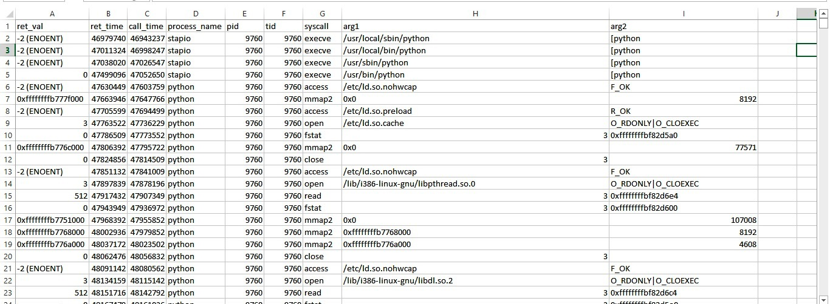
Input Data (cont’d)
A csv file containing system calls (All input sanitized to make it compatible with neo4j)

Slide 16
Mapping Relationships
Based on our data model we defined three kinds of relationships:
(Event)-[:IS_GENERATED_BY]->(Subject)
(Event)-[:AFFECTS]->(Object)
(Event)-[:AFFECTS] ->(Subject)

Slide 17
Load Input Data into Graph Database
Data is then stored into the neo4j using the “load csv from file” query as follows:
USING PERIODIC COMMIT
LOAD CSV WITH HEADERS FROM "file:///C:/trace.csv" AS row
MERGE (e:Event {SystemCall: coalesce(row.syscall, "No Value"), ReturnValue: coalesce(row.ret_value,"No Value"), ReturnTime: coalesce(row.ret_time,"No Value"), CallTime: coalesce(row.call_time,"No Value")})
MERGE (s:Subject {ProcessName: coalesce(row.process_name, "No Value"), Pid: coalesce(row.pid, "No Value"), tid: coalesce(row.tid, "No Value")})
MERGE (o:Object {Argument1: coalesce(row.arg1, "No Value"), Argument2: coalesce(row.arg2, "No Value")})
MERGE (e)-[:IS_GENERATED_BY]->(s)
MERGE (e)-[:AFFECTS]->(o)
MERGE (e)-[:AFFECTS] ->(s)

Slide 18
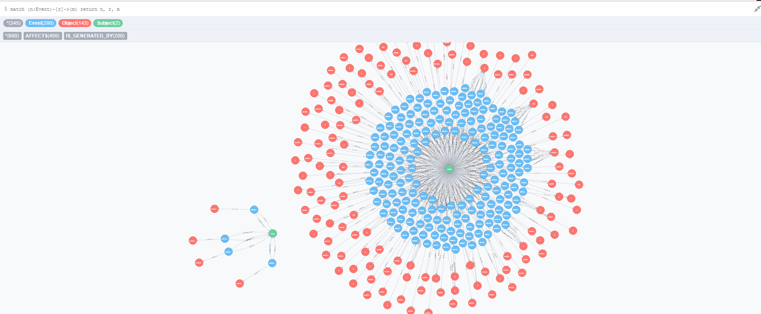
Visualizing the Result
View the graph with the following query
match (n:Event)-[r]->(m)
return n, r, m

Slide 19
Few More Queries
Finding all paths between two specific nodes
match p=(a)-[:IS_GENERATED_BY*]-(c)
where a.SystemCall='open' and c.ProcessName='python‘
return p order by length(p)
Finding all path length between two specific nodes
match p=(a)-[:IS_GENERATED_BY*]-(c)
where a.SystemCall='open' and c.ProcessName='python‘
return length(p)
Finding diameter of the graph
match (e:Event), (s:Subject)
where e <> s
with e, s
match p=shortestPath((e)-[*]->(s))
return e.SystemCall, s.ProcessName, length(p)
order by length(p) desc limit 1

Slide 20
General Queries for Analytics
Finding the depth of graph
Finding the neighbours of a particular node
Finding Paths from one node to another
Degrees of separation between different nodes
Graph diameter
In-degree and out-degree of a particular node
Construct an adjacency matrix of the graph for detailed analysis

Slide 21
Attack Detection via Graph Visualization
Traversal of tainted nodes using queries.
we can traverse tainted system nodes based on the condition where pid <> tid to find out the attack origin point
We can have a training graph of application calls in the case of normal application execution and perform a depth comparison analysis to find out if any additional malicious calls have been executed for a particular instance of application run
We can have forward tracking by taking the attack origin node as root and traverse the child tree for that node

Slide 22
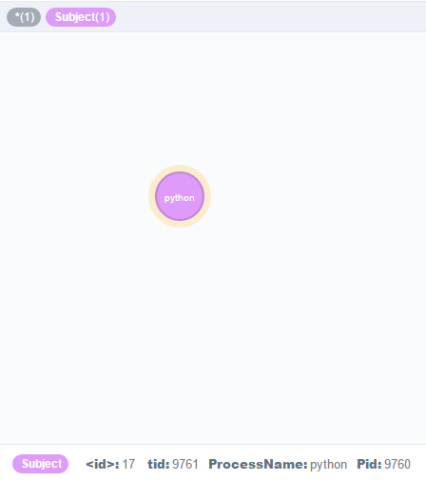
Attack Detection via Graph Visualization (cont’d)
Attack Scenario queries comparing both benign and attack scenario
Checking for node where Pid <> tid
Match (s:Subject) where s.Pid <> s.tid return (s)
Query returns one node type ‘python’ where Pid= 9760 and tid=9671

Slide 23
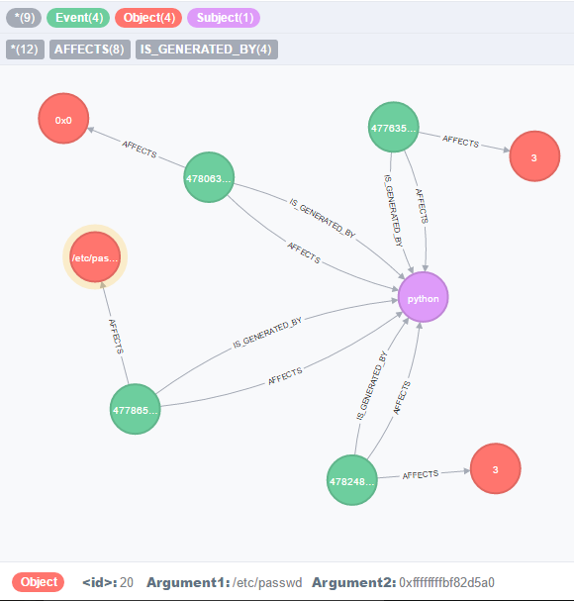
Attack Detection via Graph Visualization (cont’d)
match (n:Event)-[r]->(s:Subject) , (n:Event)-[r1]->(o:Object)
where s.Pid <> s.tid
return n, r, s, o
Query shows connections of the node that was created with a different ‘tid’
Note that etc/passwd file is being opened by the new thread

Slide 24
Advantages of our Approach
Approach works for all kinds of applications - web and desktop
Good visualization technique for understanding the attack
Fast query performance

Slide 25
Limitations
Whilst working on community edition of the Neo4J, visualization scope is limited.
Loading large datasets into the DB takes time depending on the system configuration

Slide 26
Conclusion & Future Work
This is just a very basic framework implementation of the idea of graph analytics for Intrusion Detection.
The framework has been evaluated on the data gathered by different teams.
The technique can be used for both web and desktop applications
New queries need to be written for implementing new intrusion detection policies
Improve performance of data loading to the graph db.

Slide 27
References
Neo4J Manual v2.3.3
Neo4J Lynda Tutorial
Backtracking intrusions - King and Chen
Taint Enhanced Policy Enforcement - Xu, Bhatkar, Sekar
High Accuracy Attack Provenance via Binary-based Execution Partition - Xu, Lee, Zhang
Neo4J with Cypher – Coursera Tutorial

Slide 28
Questions?

